Slide 1

Project Name
HustleHarmony
TEAM: Fusion4

Slide 2
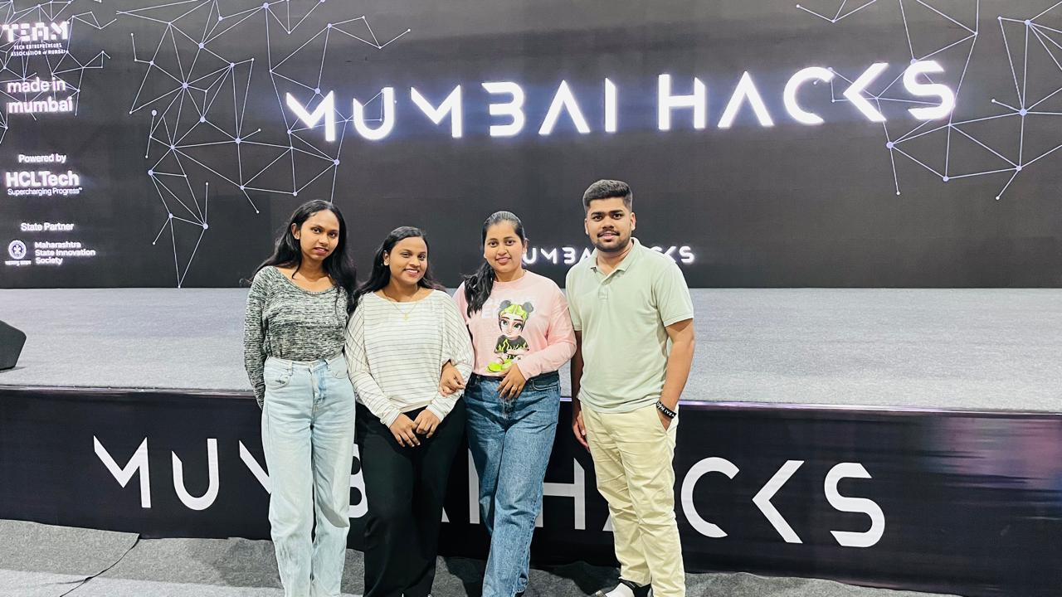
A picture of your team!
Karan Kale | Anjali Sah | Akshada Katare | Nirmala chauhan

Slide 3
Problem Statement
Gig and informal workers face inconsistent income, unpredictable expenses, and lack adaptive financial tools. Traditional budgeting apps fail because they depend on manual input and do not adjust to real-time income variability.

Slide 4
Solution
HustleHarmony is an autonomous AI financial co-pilot that tracks income and expenses in real-time, predicts cash flow, automates micro‑decisions, and provides personalized financial coaching for variable‑income users.

Slide 5
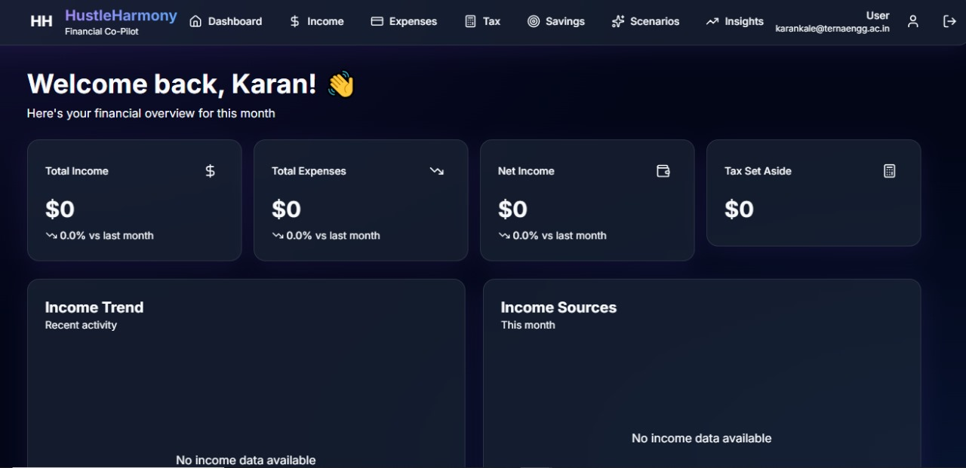
UI Placeholder: Dashboard showing cash flow, income tracking, alerts.
: Dashboard showing cash flow, income tracking, alerts.

Slide 6
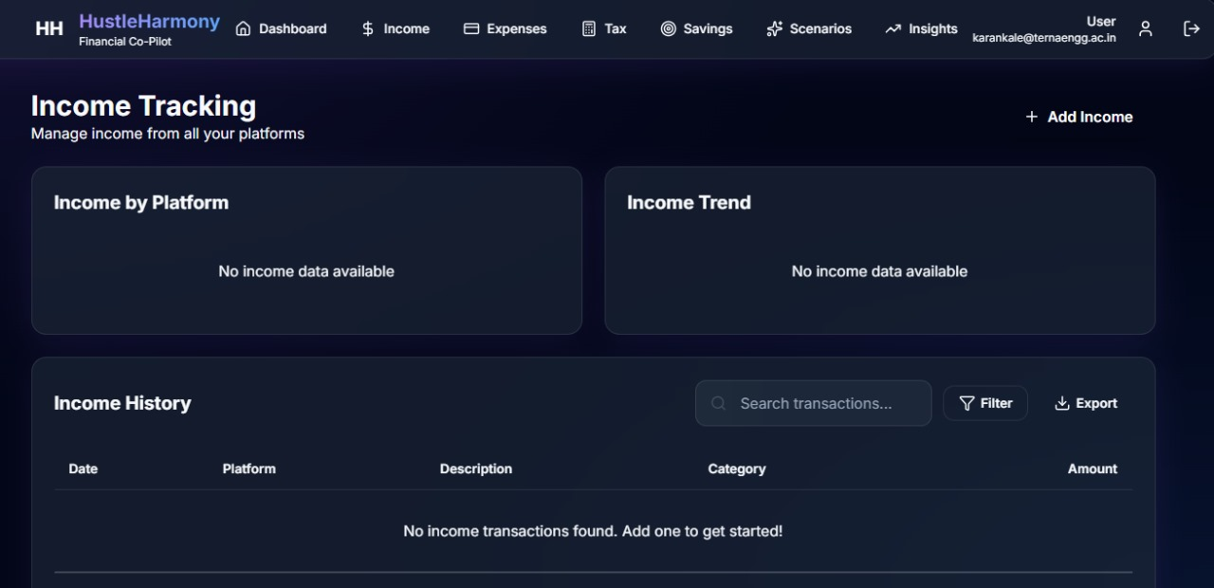
. UI Placeholder: AI recommendation panel with explainable insights.

Slide 7
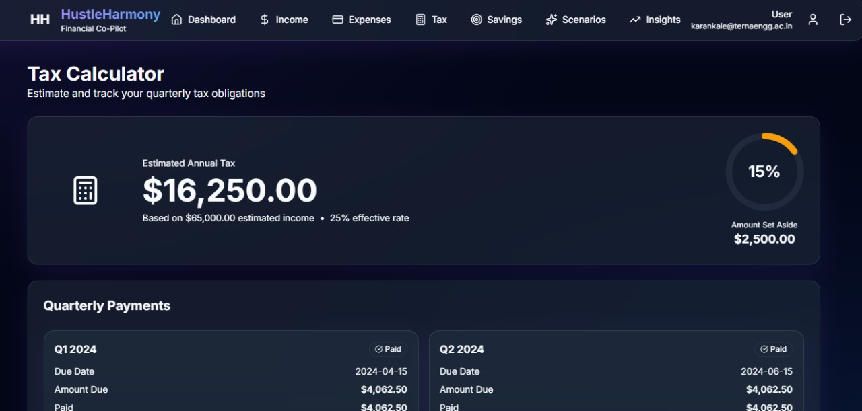
UI Placeholder: Scenario simulator and smart budgeting screen.

Slide 8
Business Model
Freemium model: Free basic insights.
Premium: Advanced predictions, automations, goal optimization.
Future: API partnerships with gig platforms and fintech services.

Slide 9
Anything else?
Launch Plan:
• MVP in 2 months
• Beta with 200 gig workers
• Partner with delivery platforms
Notes:
HustleHarmony is designed to become India’s most trusted financial autopilot for gig earners.

Slide 10
Thank you
Our favorite part of MumbaiHacks 2025: Building with brilliant founders and nonstop energy!

